Slide 1
Formatting Text

Slide 2
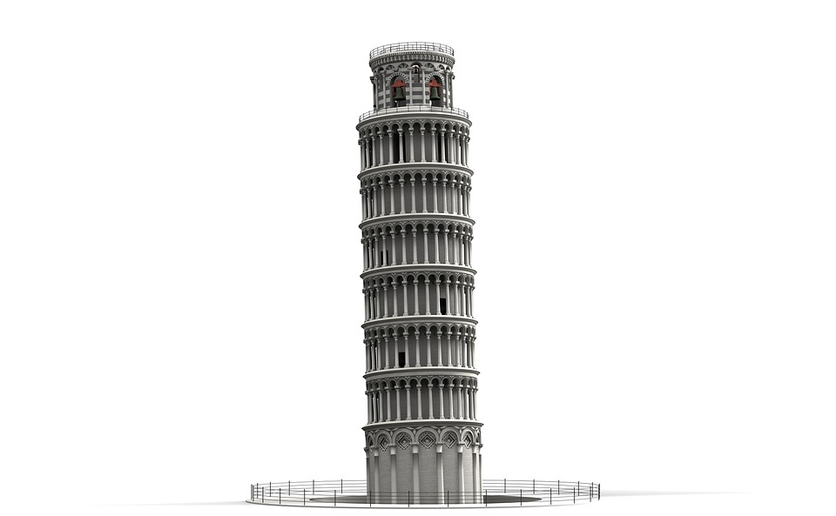
We can build standard web pages...
<h1>
</h1>

Slide 3

… now let’s add some style
<i>
</i>

Slide 4
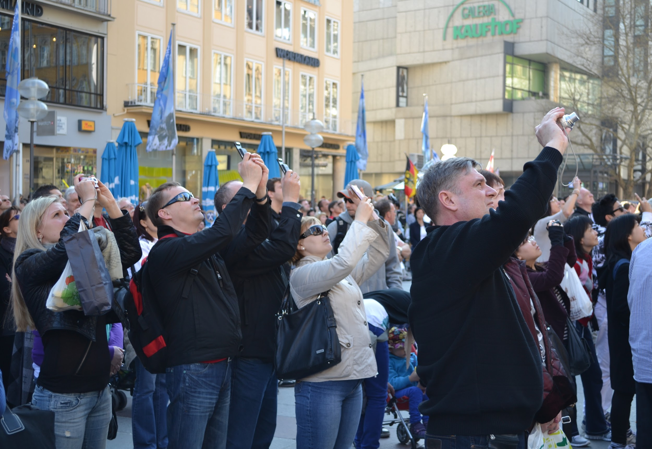
… now let’s add some style
<i>
</i>
image source: https://upload.wikimedia.org/wikipedia/commons/thumb/d/df/Tourists_in_Munich_at_the_Marienplatz%2C_2011.JPG/800px-Tourists_in_Munich_at_the_Marienplatz%2C_2011.JPG

Slide 5
HTML Formatting
HTML provides several tags for formatting text on your web pages

Slide 6
The <p> Tag
Tag: <p> - Paragraph of text
HTML:
Result:

Slide 7
The <p> Tag
Tag: <p> - Paragraph of text
HTML: <p>Paragraph 1</p>
<p>Paragraph 2</p>
Result:

Slide 8
The <p> Tag
Tag: <p> - Paragraph of text
HTML: <p>Paragraph 1</p>
<p>Paragraph 2</p>
Result: Paragraph 1
Paragraph 2

Slide 9
The <p> Tag
Tag: <p> - Paragraph of text
HTML: <p>Paragraph 1</p>
<p>Paragraph 2</p>
Result: Paragraph 1
Paragraph 2
Note there’s an automatic line break (new line) after a paragraph tag

Slide 10
The <p> Tag
Tag: <p> - Paragraph of text
HTML: Paragraph 1
Paragraph 2
Result: Paragraph 1
Paragraph 2

Slide 11
The <p> Tag
Tag: <p> - Paragraph of text
HTML: Paragraph 1
Paragraph 2
Result: Paragraph 1 Paragraph 2

Slide 12
The <p> Tag
Tag: <p> - Paragraph of text
HTML: <p>Paragraph 1</p>
<p>Paragraph 2</p>
Result: Paragraph 1 Paragraph 2

Slide 13
The <p> Tag
Tag: <p> - Paragraph of text
HTML: <p>Paragraph 1</p>
<p>Paragraph 2</p>
Result: Paragraph 1
Paragraph 2

Slide 14
The <i> Tag
Tag: <i> - Italicized Text
HTML:
Result:

Slide 15
The <i> Tag
Tag: <i> - Italicized Text
HTML: This is <i>important!</i>
Result:

Slide 16
The <i> Tag
Tag: <i> - Italicized Text
HTML: This is <i>important!</i>
Result: This is important!

Slide 17
The <b> Tag
Tag: <b> - Bold Text
HTML:
Result:

Slide 18
The <b> Tag
Tag: <b> - Bold Text
HTML: I’ll be <b>back</b>
Result:

Slide 19
The <b> Tag
Tag: <b> - Bold Text
HTML: I’ll be <b>back</b>
Result: I’ll be back

Slide 20
The <hr> Tag
Tag: <hr> - Horizontal Rule
No closing tag
Creates a horizontal line on the screen

Slide 21
The <hr> Tag
Tag: <hr> - Horizontal Rule
<p>Above</p>
<hr>
<p>Below</p>

Slide 22
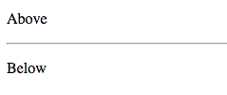
The <hr> Tag
Tag: <hr> - Horizontal Rule
<p>Above</p>
<hr>
<p>Below</p>

Slide 23
Line Breaks
Tag: <br> - Line Break
No closing tag
Creates a new line / blank line

Slide 24
Line Breaks
<p>
P. Sherman
42 Wallaby Way
Sydney, Australia
</p>

Slide 25
Line Breaks
<p>
P. Sherman
42 Wallaby Way
Sydney, Australia
</p>
P. Sherman 42 Wallaby Way Sydney, Australia

Slide 26
Line Breaks
<p>
P. Sherman
42 Wallaby Way
Sydney, Australia
</p>
P. Sherman 42 Wallaby Way Sydney, Australia
All whitespace in an HTML document gets displayed as single spaces in the resulting web page!!

Slide 27
Line Breaks
<p>
P. Sherman
42 Wallaby Way
Sydney, Australia
</p>
P. Sherman 42 Wallaby Way Sydney, Australia
All whitespace in an HTML document gets displayed as single spaces in the resulting web page!!

Slide 28
Line Breaks
<p>
P. Sherman<br>
42 Wallaby Way<br>
Sydney, Australia<br>
</p>
P. Sherman 42 Wallaby Way Sydney, Australia

Slide 29
Line Breaks
<p>
P. Sherman<br>
42 Wallaby Way<br>
Sydney, Australia<br>
</p>
P. Sherman
42 Wallaby Way
Sydney, Australia

Slide 30
Line Breaks
<p>
P. Sherman<br>
42 Wallaby Way<br>
Sydney, Australia<br>
</p>
<br> - Line Break
P. Sherman
42 Wallaby Way
Sydney, Australia

Slide 31
Headings
We saw <h1> before.
There is also
<h2></h2>
<h3></h3>
<h4></h4>
<h5></h5>
<h6></h6>

Slide 32
Headings
We saw <h1> before.
There is also
<h2></h2>
<h3></h3>
<h4></h4>
<h5></h5>
<h6></h6>
As the number gets bigger, the heading gets smaller.

Slide 33
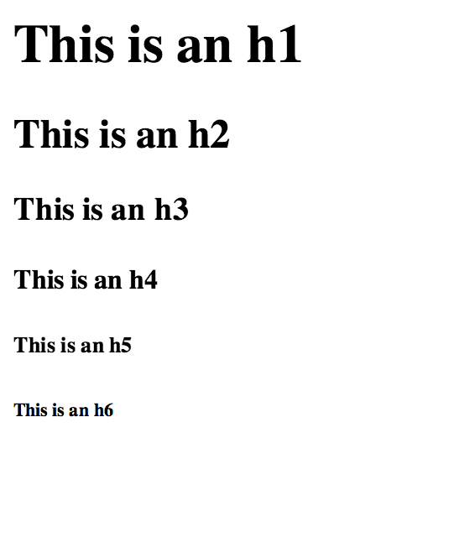
Headings
<h1>This is an h1</h1>
<h2>This is an h2</h2>
<h3>This is an h3</h3>
<h4>This is an h4</h4>
<h5>This is an h5</h5>
<h6>This is an h6</h6>

Slide 34
Nesting Tags
This is <b>very important!</b>
This is very important!

Slide 35
Nesting Tags
This is <i><b>very important!</b></i>
This is very important!

Slide 36
Formatting Tags
<p> | paragraph
<i> | Italic
<b> | Bold
<hr> | horizontal rule
<br> | Line Break
<h1>,<h2>...<h6> | headings (h1 = largest, h6 = smallest)

Slide 37
Let’s see this in the editor!

